Slide 1
Go Tutorial
https://www.w3schools.com/go/index.php

Slide 2
Introduction & Advantageous
Statically typed
Fast run time ( Run fast )
  Fast compile time to produce machine language code
Supports concurrency through go-routines and channel
  small cost for using it
Has automatic garbage collection
Simpler Objects
  Does not support classes and objects
  Does not support inheritance
Concurrency is efficient

Slide 3
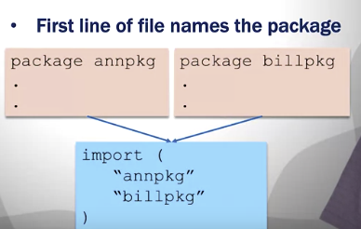
Workspace and Packages
Workspace – where your code goes ( recommended but not enforced )
  In the workspace
    src
    packages that are linkedin ( pkg)
    bin
  Programmer typically has one workspace for many projects
  Workspace directory is defined by the GOPATH environment varibles
Packages
  Group of related source code files
  Each package can be imported by other packages
  First line of file names the package using the package keyword
  There must be one package called main – Where execution starts
    When you compile the main package get an executable
    When you compile another package don’t get a main

Slide 4
Go Tool
go build – compiles the program
  list of package or list of filenames of .go files
  When creating an executable get the first name of the first go file listed
go doc – prints documentation for a a package
go fmt
go get – downloads packages and installs them
go list – list installed packages
go run – compile and run
go test – run tests using the files ending in _test.go

Slide 5
Go Syntax
A Go files consist of
  Package Declaration
    Every program is part of the package
  Imports packages
    import(“fmt”) – Imports the fmt package
    search in the directory GOROOT and GOPATH environmental variables
  Functions
  Statements and Expressions
    Statements are separated by
      Enter key
      semicolon

Slide 6
Comments
Single Line Comments //
Multiline Comments /* */

Slide 7
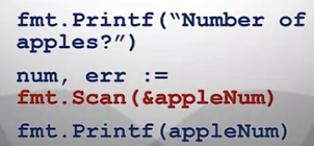
Scan
Reads the input
Takes a pointer as an argument
Type data is written to pointer
program is blocked until enter is hit and what the user type in will put into the variable
Returns number of tokens and error
  if error == nil then no error

Slide 8
Go Variables
Type of Variables – Note all variables have a default value if not assigned one.
  int default value Is 0
  float32 default values is 0.0
  string default: “”
  bool default: false
Creating Variables
  With the var keyword
    var variable_name type = value
    Ex. var student1 = “John”
    Ex. var a, b =6, “Hello”
    Can be used inside and outside of functions
  With := type is inferred and cannot declare a variable without assigning a value
    variable_name := value
    Ex. x := 2
    Ex. c , d := 7, “Hello”
    Can be used inside functions

Slide 9
Go Variables
Naming Rules
  A variable must start with a letter or an underscore, but not digits
  A variable name can contain a-z, A-Z, 0-9 and underscore
  Case Sensitive
  No Limit on the length
  Cannot contain spaces
  The variable name cannot be any Go Keywords
Different Cases
  Came Case : myTest
  PascalCase: MyTest
  Snake Case: my_test
Once the variable is defined it can only store data type
Type – Create an alias for a variable
  type Celsius float64

Slide 10
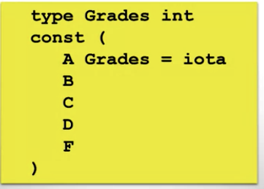
Constants
Unchangeable and readonly
const CONSTNAME type = value
Example: const PI = 3.14, const PI float32 = 3.14
Constant should be written outside functions
Constant can be declared inside/outside functions
iota
  Generate a set of related by distinct constants
  often represents a property which has several distinct possible values
    Ex Days of week
    Ex months of year
    Constants need to be different, but the actual value is not important
    Like a enumerated type in other languages

Slide 11
Go Output Functions
Example
  package main
  import(“fmt”)
  func main() {
    var I,j string = “Hello”, “World”
    fmt.Print(i, “\n”, j)
  }
Println() – Whitespace is added between the arguments and a new line is added at the end
Printf() – formats its argument based on the given formatting verb and then prints them
  %v is used to print the value of the arguments
  %T is used to print the type of the arguments
  Example
    var I string = “Hello”
    fmt.Printff(“i has the value: %v and type %T\n”, I, i)

Slide 12
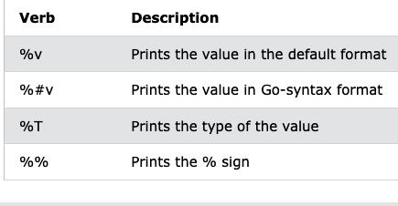
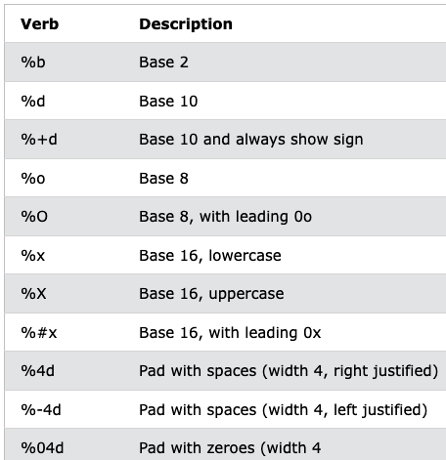
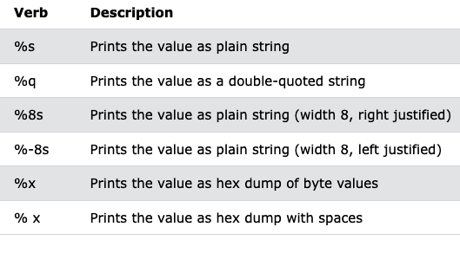
Go Output Functions
Tables showing the formatting version

Slide 13

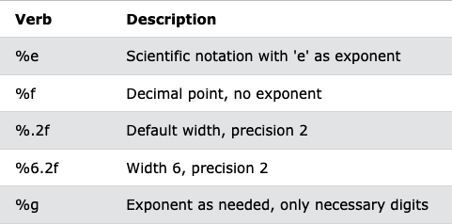
Go Output Functions
Tables showing the formatting version

Slide 14
Go Datatypes
Integer Data Types
  int -- 32 bits
  int 8 -- 8 bits
  int16 – 16 bits
  int32 – 32 bits
  int64 – 64 bits
Unsigned Integers
  unit – 32 bits
  unit8 – 8 bits
  unit16 – 16 bits
  uint32 – 32 bits
  uint64 – 64 bits
float
  float 32
  float 64
String – representing in unicode

Slide 15
Int , Floats, Strings
Integer
  Example –
    var x int32 = 1
    var x int16 = 2
    x = y // Assignment would fail since int32 is not the same as int16
  Use Convert type with T() Operation
    x = int32(y)
Floating Points
  float32 ~6 digits of precision
  float64 ~15 digits of precision
  Express floating points numbers using decimals or scientific notation
    var x float64 = 123.45
    var y float64= 1.2345e2
Complex number represented by var z complex128 = complex(2,3)

Slide 16
Type Conversions
Unicode
  A 32 bit character code
  UTF-8 is variable length
    subset of UNICODE
    8 bit UTF codes are the same as ascii
    represents a lot more characters than ASCII – Don’t let the 8 bit code confuse you
    default in GO
  Code Points – Unicode characters
    2^32 Code points
    Rune = Code point in go
Strings
  Read Only
  String literal – “Hi There”
    Each byte ( H, I, <space>, T, h, e, r, e ) is a rune

Slide 17
String Packages
Unicode Package
  Runes are divided into many different categories
  Provides a set of functions to test categories of runes
    isDigit(r rune)
    isSpace(r rune)
    isLetter(r rune)
    isLower(r rune)
    isPunct(r rune)
  Conversions
    ToUpper(r rune)
    ToLower(r rune)
Strings Package
  Functions to manipulate UTF-8 encoded strings
  String search functions
    Compare(a,b) 0 if a == b, -1 if a < b and + 1 if a > b
    contains( s, substr)

Slide 18
String Packages
    hasPrefix(s, prefix)
    Index(s, substr) – returns index of the first instance
String Manipulation
  Replace(s, old, new, n)
  returns a copy of string s with the first n instances of old replace by new
  ToLower(s)
  ToUpper(s)
  TrimSpace(s)
Strconv Package
  Conversions to and from string representations of basic data types
  Atoi(s)
  itoA
  formatFloat(f, fmt, prec, bitSize) – Converts floating point number to string
  parseFloat(s, bitsize) – converts a string to a floating point number

Slide 19
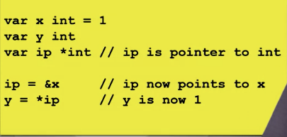
Pointers
An address to data in memory
Operators
  & Returns the Address
  * Deference
new() – Creates a variable and returns a pointer to the variable
  variable is initialized to 0
  Ex ptr := new(int)
  *ptr = 3

Slide 20
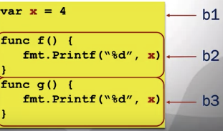
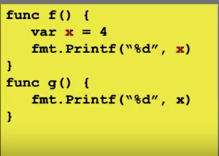
Variable Scope
Variable scoping is done using blocks
  A sequence of declarations and statements within matching brackets
  Notice function definitions are start and end with blocks
  Each block can have its own variables associated with it
  Hierarchy of implicit blocks
    Implicit Blocks ( Universal,Package, File )
    Universe block – all go source
      Package block – All source code in a particular package
        File – All the source code in a file
          Other blocks include the if,for,switch
            Clauses inside a switch or select
Lexical Scoping – How references are resolved
  Go is lexically scope using blocks
  1st picture – Both B2 and B3 would have x = 4 and B1 is a file block
  2nd picture – When g tried to reference g it does not see it in the local / file / package block / universe so there is an error

Slide 21
Deallocating
When a variable is no longer it is deallocated
Memory
  Stack – dedicated to function calls
    local variables go there
    deallocated after function completes
  Heap is persistent

Slide 22
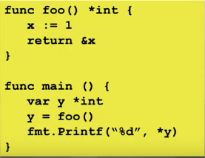
Garbage Collection
Deallocate only when the variable is no longer being used.
In thee first example returning an address to a deallocated variable
Garbage collection deals with deallocation
  Go is a compiled language so garbage collection is in use
  There is a performance hit which is a trade off

Slide 23
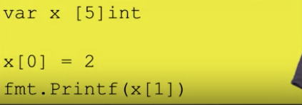
Go Arrays
Declaring an array with the var keyword
  var array_name = [length]datatype{values}
  var array_name :=[length]datatype(values)
Array have fixed values
Examples
  var arr1 = [3]int{1,2,3}
  arr2 := [5]int{4,5,6,7,8}
index is 0 based
arr1 := [5]int{} //not initialized
  Uses the default values that type would use to initialize each index
Initialize specific elements
  func main() {
  arr1 := [5]int{1:10,2:40}
find the length of an array – len(arr1)
Elements are initialized to zero value

Slide 24
Go Arrays
Array Literal – An array pre-defined with values
  var x [5]int = [5]{1,2,3,4,5}
  length of literal must be the same as the array
  … is a key used to express the size ( infers size from number of initializers )
    x := [...]int{1,2,3,4}
Iterating through arrays
  x := [3]int {1,2,3}
  for I, v range x { // I is the index and v is the value
    fmt.Printf(“index %d, val %d”, I, v)
  }

Slide 25
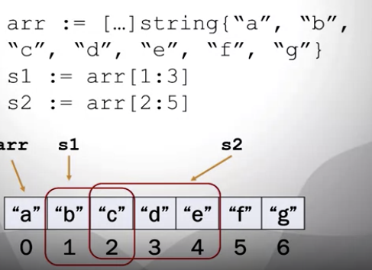
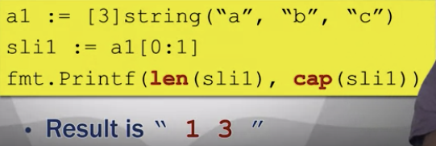
Go Slices
Slices – similar to array, but can grow and shrink
  A window on an underlying array that is the basis for the array
  can be the same size or smaller than the underlying array
  can increase the size of the array
Create a Slice With []datatype{values}
  slice_name := []datatype{values}
  myslice := []int{}
    Length of 0 / capacity of 0
  myslice := []int{1,2,3}
    Length of 3 / capacity of 3
Functions
  len()
  cap() – The number of elements the slice can grow or shrink to
Create a slice from an Array
  arr1 := [6]int{10, 11, 12, 13, 14,15}
  myslice := arr1[2:4] // Length is 2, but the capacity is 4
  myslice := arr1[0:4] // Length is 4, b ut the capacity

Slide 26
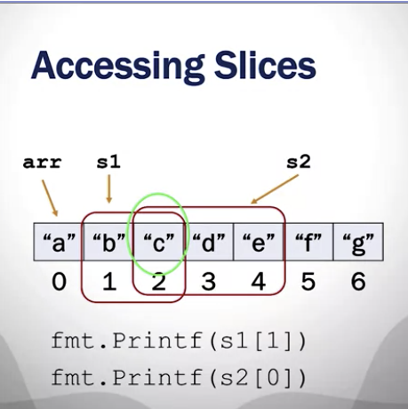
Go Slices
make() function – Want to use the variable size, but don’t care about the array.
  slice_name := make([]type, length, capacity)
    capacity is optional. not specified then capacity = length
  myslice1 := make([]int, 5, 10)
  myslice2 := make([]int, 5)
Access a slice just like you would an array. The beginning index I 0
  Writing to the underlying array and any other array that access the specific index
  Example
    prices := []int{10,20,30}
    prices[0]
    prices[1] = 500
Append elements to the slice – Used to increase the size of the slice
  Example
    myslice1 := []int{1, 2, 3, 4, 5, 6}
    myslice1 = append(myslice1, 20, 21) length = 6 / capacity = 6
      new array is [1,2,3,4,5,6,20,21]
    append does have a time limit hit.

Slide 27
Go Slices
Slice literals
  Can be used to initialize a slice
  Creates the underlying array and creates a slice to reference it
  Slice points to the stat of array, length is capacity
  Example
    sli := []{1,2,3} – No this is a slice liter since the size of the index is missing
    Ex. sli := []int{1,2,3}
Every slice has
Pointer – Indicates the start of the slice
Length – The number of elements in the slice
Capacity – Maximum number of elements
  From the start of the Slick to the Array

Slide 28
Go Slices
Change the length of a slice
  arr1 := [6]int{9, 10, 11, 12, 13, 14}
  myslice1 := arr1[1:5] // Slice array // length = 4 , capacity = 5
  myslice1 = arr1[1:3]
  // Change length by re-slicing the array // length = 2, capacity = 5
  myslice1 = append(myslice1, 20, 21, 22, 23)
    // Change length by appending items // length = 6, capacity is 10

Slide 29
Go Operators
Arithmetic : +, -, * , /, %, ++ , – , = , +=, -=, *=, /=,
  &= bitwise and
  ^= bitwise exclusive-or
  >>= right shift
  <<= left shift
Comparison: ==, !=, >, <, >=, <=
Logical &&, ||, !
Bitwise: & (and), | (OR), ^ (XOR), <<, >>

Slide 30
Go Conditions
Having the else brackets in a different line will raise an error:
  Example
    if (temperature > 15) {
    fmt.Println("It is warm out there.")
    } // this raises an error
    else {
    fmt.Println("It is cold out there.")
    }
Example
  time := 22
  if time < 10 {
  fmt.Println("Good morning.")
  } else if time < 20 {
  fmt.Println("Good day.")
  } else {
  fmt.Println("Good evening.")
  }

Slide 31
Go Switch
Example
  day := 8
  switch day {
  case 1:
  fmt.Println("Monday")
  case 2:
  fmt.Println("Tuesday")
  case 3:
  fmt.Println("Wednesday")
  case 4:
  fmt.Println("Thursday")
  case 5:
  fmt.Println("Friday")
  case 6:
  fmt.Println("Saturday")
  case 7:
  fmt.Println("Sunday")
  default:
  fmt.Println("Not a weekday")
  }
Tag is compared to a constant defined in each case

Slide 32
Go Switch
Example
  day := 5
  switch day {
  case 1,3,5:
  fmt.Println("Odd weekday")
  case 2,4:
  fmt.Println("Even weekday")
  case 6,7:
  fmt.Println("Weekend")
  default:
  fmt.Println("Invalid day of day number")

Slide 33
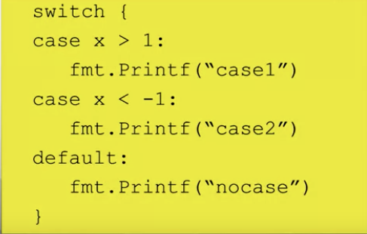
Tagless Switch
Each case does not have a constant, but an expression
  Executes the first case that is true

Slide 34
For Loop and Continue and break
Example
  package main
  import ("fmt")
  func main() {
  for i:=0; i < 5; i++ {
  if i == 3 {
  continue
  }
  fmt.Println(i)
  }
  }
  Example --Infinite loop
    for {
      fmt.Printf(“Hi”);
      }

Slide 35
For Loop and Continue and break
i:=0; i < 5; i++ {
if i == 3 {
break
}
fmt.Println(i)
}

Slide 36
Functions
Example
  package main
  import ("fmt")
  func myFunction(x int, y int) int {
  return x + y
  }
  func main() {
  fmt.Println(myFunction(1, 2))
  }

Slide 37
Functions
func myFunction(x int, y string) (result int, txt1 string) {
result = x + x
txt1 = y + " World!"
return
}
func main() {
a, b := myFunction(5, "Hello")
fmt.Println(a, b)
}

Slide 38
Struct
Example – Create a structure, Initializing and Accessing
  type Person struct {
  name string
  age int
  }
  func main() {
  var pers1 Person
  // Pers1 specification
  pers1.name = "Hege"
  pers1.age = 45
  printPerson(pers1)
  }
  func printPerson(pers Person) {
  fmt.Println("Name: ", pers.name)
  fmt.Println("Age: ", pers.age)
  }

Slide 39
Go Maps
A map is an unordered and changeable collection that does not allow duplicates that contains key/value pairs
The default value is null
Maps hold references to an underlying hashtable
Creating Maps
  var a = make(map[KeyType]ValueType)
  Example of creating maps
    var a = map[string]string{"brand": "Ford", "model": "Mustang", "year": "1964"}
    b := map[string]int{"Oslo": 1, "Bergen": 2, "Trondheim": 3, "Stavanger": 4}
    using make()
      var a = make(map[string]string) // The map is empty now
      a["brand"] = "Ford"
      a["model"] = "Mustang"
      a["year"] = "1964"
Update a value: a[“year”] = “1980”
Remove an element: delete(a,"year")

Slide 40
Go Maps
Check for a certain key exists in a map using
  val, ok :=map_name[key]
  If you only want to check for existence then replace val with _ example _ , ok :=map_name[key]
  Examples
    val1, ok1 := a["brand"] // Checking for existing key and its value
    fmt.Println(val1, ok1)
  Example
    _, ok4 := a["model"] // Only checking for existing key and not its value
    fmt.Println(ok4)
Map Are References to has tables
  If two map variables refere to the same has table, change the content of one variable affect the content of the other
  Example
    var a = map[string]string{"brand": "Ford", "model": "Mustang", "year": "1964"}
    b := a
    b["year"] = "1970" – Will change both variables a,b

Slide 41
Go Maps
Example
  a := map[string]int{"one": 1, "two": 2, "three": 3, "four": 4}
  var b []string // defining the order
  b = append(b, "one", "two", "three", "four")
  for k, v := range a { // loop with no order
  fmt.Printf("%v : %v, ", k, v)
  }
  for _, element := range b { // loop with the defined order
  fmt.Printf("%v : %v, ", element, a[element])
  }

Slide 42
Object
Organize your through code through encapsulation
Groups together data and function which are related
Use defined type which is specific to application
No inheritance, constructors or generics
  generics was added later on

Slide 43
Concurrency
Go includes concurrency primitives
  coroutines – represent concurrent tasks
  channels – Communicate between tasks
  select – enable task synchronization

